Slide 1
Which cloud platforms
(AWS, Azure, Google Cloud)
are associated with the highest salaries?
By: Owen Brown and Cole Smith
Capstone Project:
SDT 100 01: Intro Data Science and Business Analytics

Slide 2
Business context: Why does it matter?
AWS, Azure, and GCP are the three leading cloud platforms used worldwide.
Most companies rely on these platforms for daily operations and efficiency.
Skilled cloud professionals are in short supply, driving salaries upward.
Employers must compete for talent, making cloud expertise highly valuable.
Amazon Web Services
(AWS)
Microsoft Azure
Google Cloud Platform
IBM Cloud
Oracle Cloud
Alibaba Cloud

Slide 3
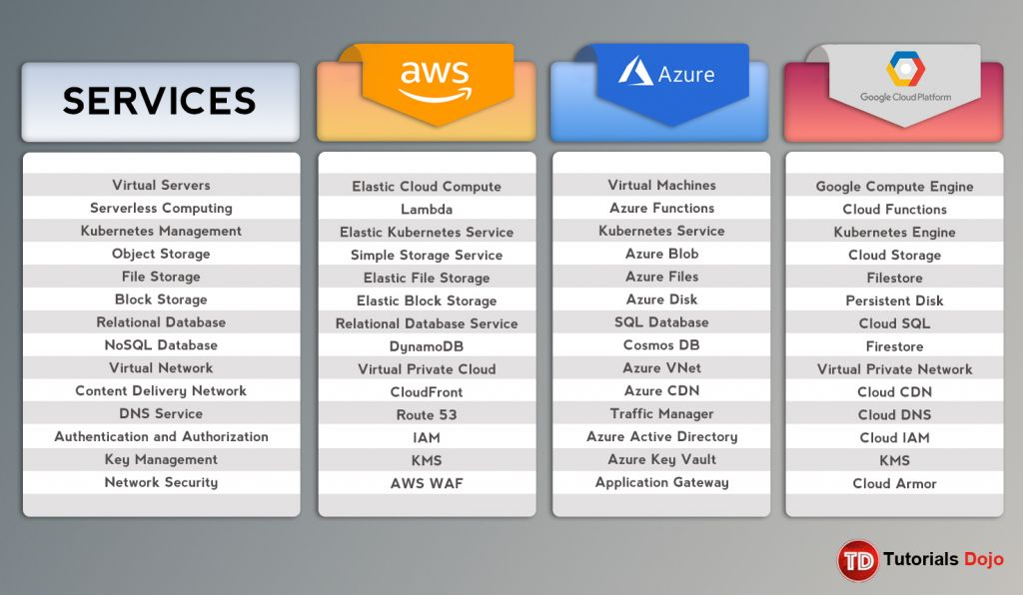
Research context: Why does it matter?
Helps job seekers compare salary differences among AWS, Azure, and GCP skill sets.
Helps identify which platform expertise commands the highest compensation.
Supports companies in budgeting for cloud roles and staying competitive.
Help job seekers choose which cloud platform skills offer the best financial return
Helps job seekers to find where the competition is

Slide 4
Data overview
Sample size
3,606 people
Variable 1
PlatformHaveWorkedWith : Cloud platforms used
Variable 2
ConvertedCompYearly : Annual salary
Variable 3
YearsCodePro : Experience

Slide 5
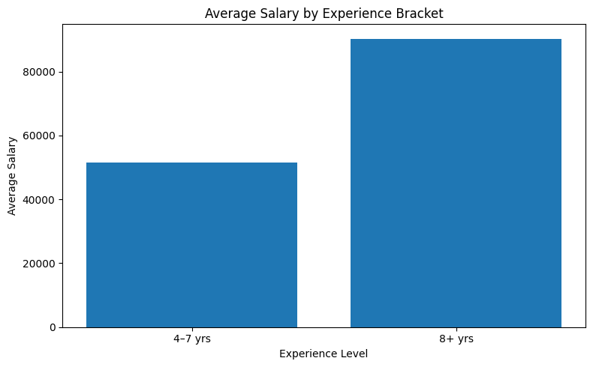
Visualization - Showing Key Relationship
AWS often leads slightly for overall high-paying jobs, followed closely by Azure and GCP
GCP architects sometimes commanding higher specific salaries due to niche skills, while GCP also offers competitive pricing for certain services, influencing overall cost-to-salary perception.
AWS roles like SRE, Solutions Architect, and Machine Learning Engineer are top earners
Azure boasts strong roles like Infrastructure Engineer and Developer
GCP shines in specialized areas like AI/Machine learning.

Slide 6
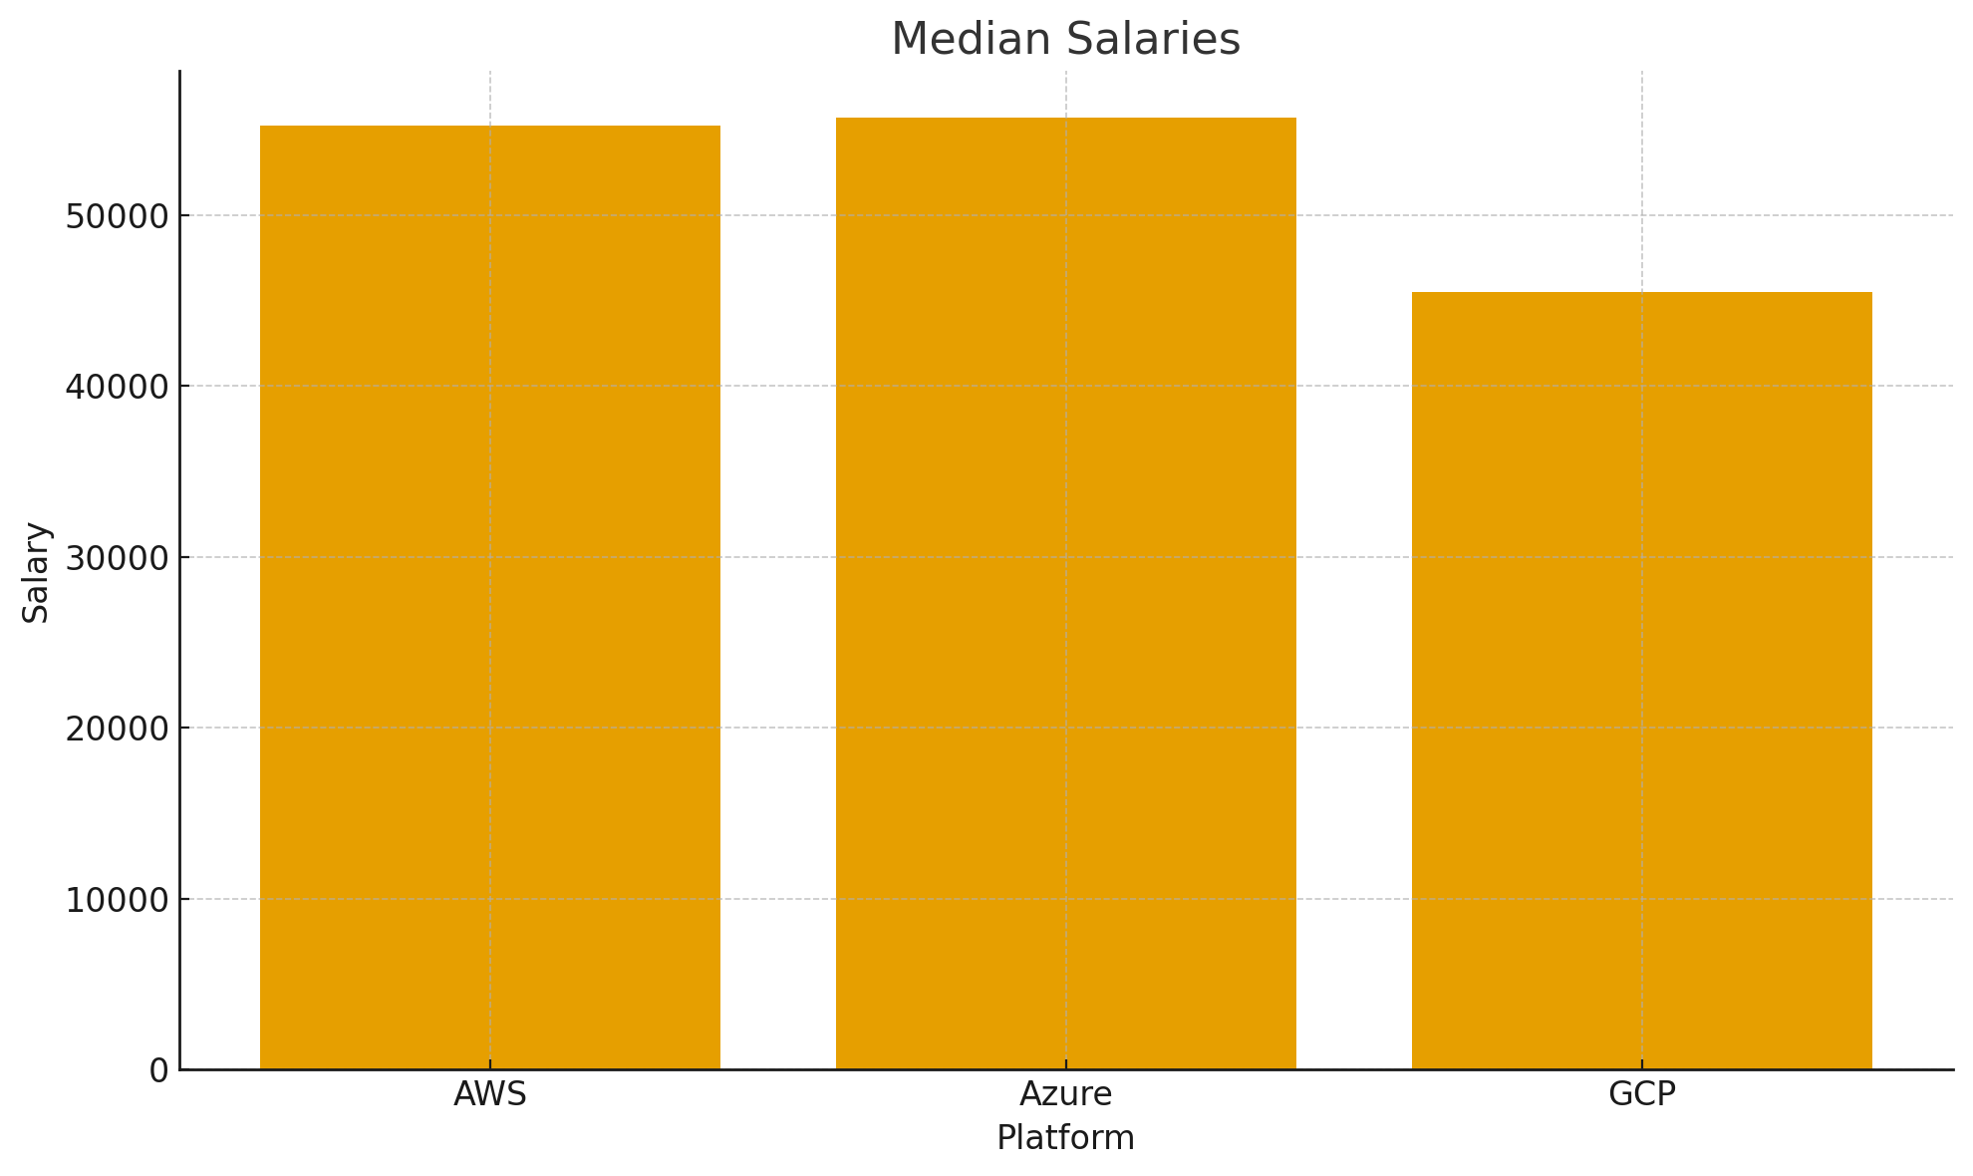
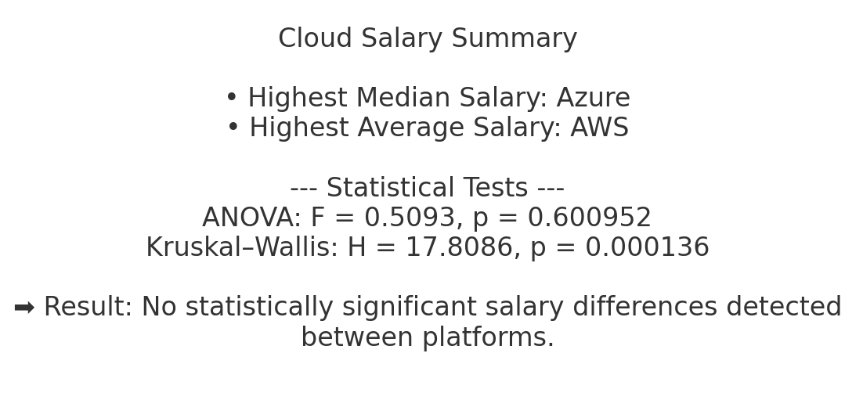
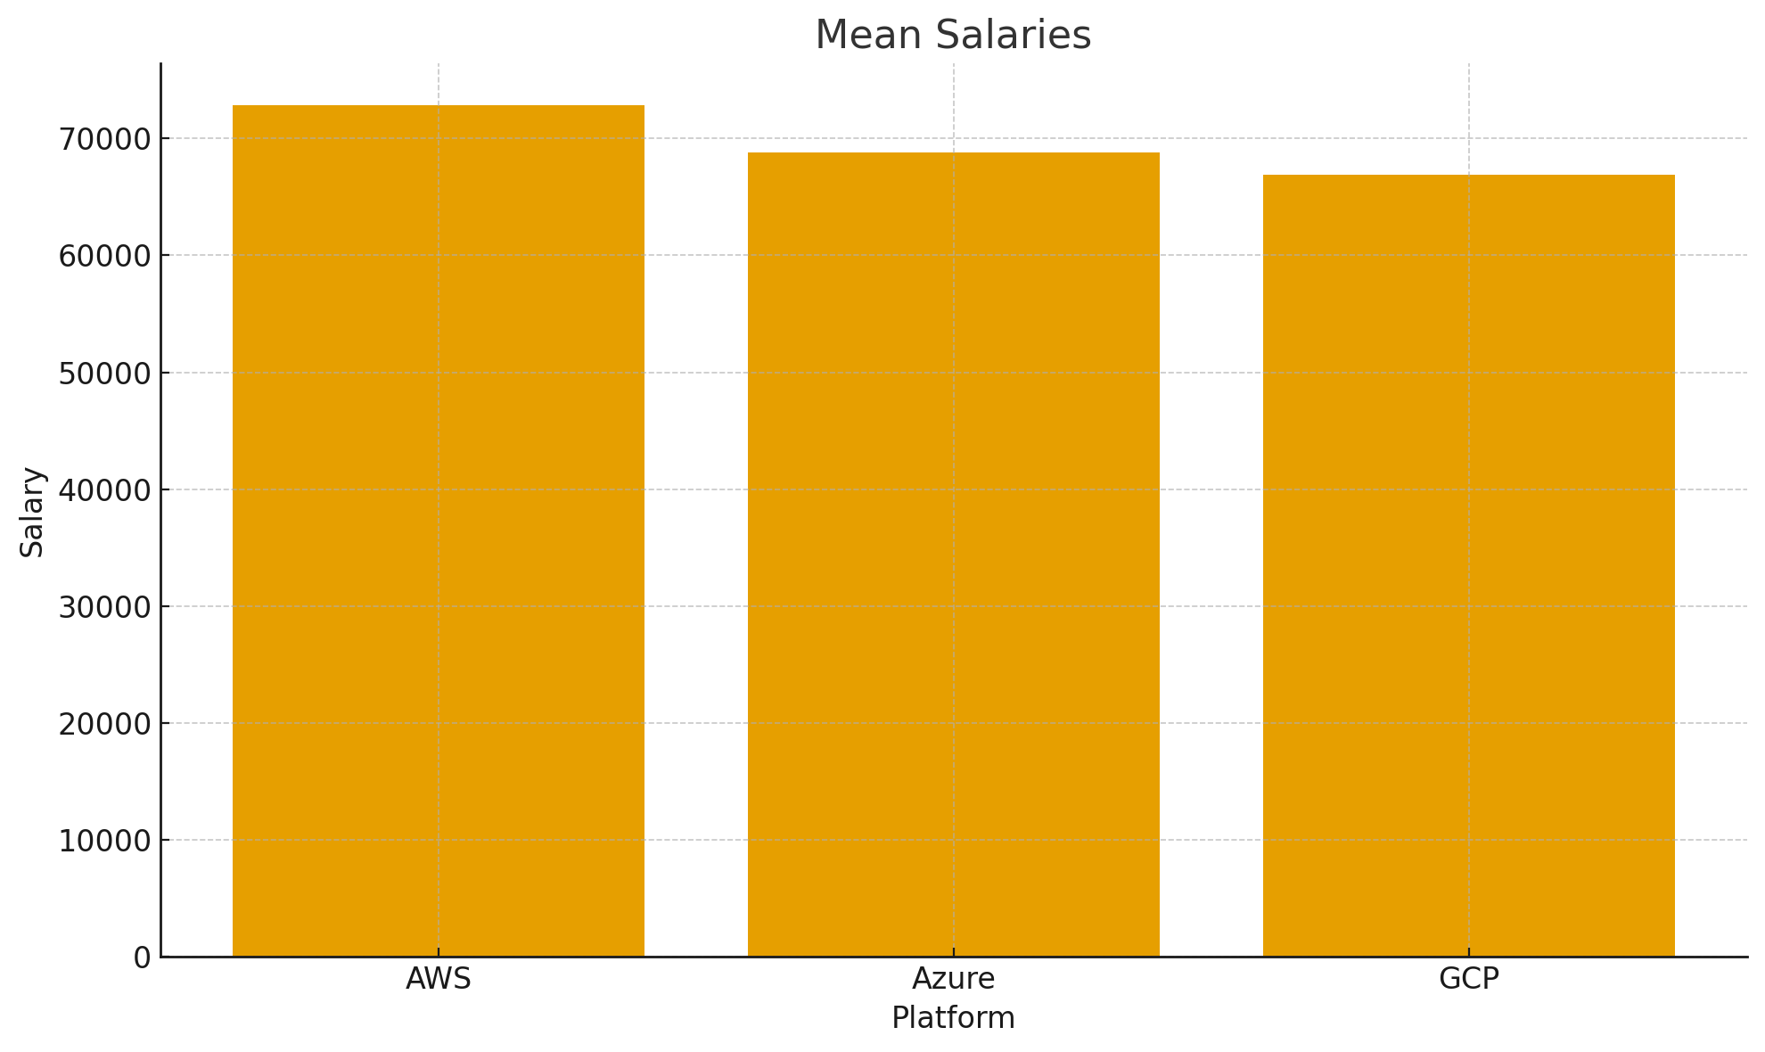
Statistical Results - Test Outcome/Interpretation - 1
AWS’s higher Mean indicates that it has a large amount of positively skewed data, indicating a large amount of highly-paid outliers
Assuming outliers, median is the best option for finding a true average, giving Azure the upper hand with the average worker
According to ANOVA, no statistically significant salary differences were found between the platforms, but ANOVA is best for normal distributions. Given that we have some varying salaries, Kruskal-Wallis may be best.
ANOVA which uses Mean saw no difference, but in the Medians, which is used by Kruskal-Wallis test, GCP’s salary appears to be lower, which fits with the Kruskal test indication of at least 1 significant difference in salaries

Slide 7
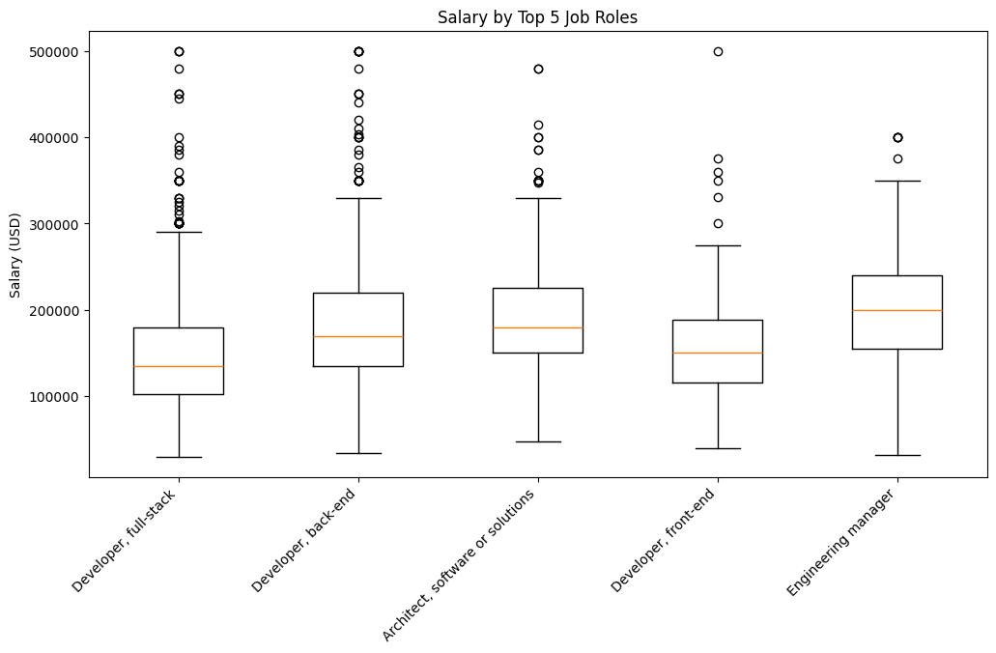
Statistical Results - Test Outcome/Interpretation - 2
Engineering Managers and Architects have the highest salaries, reflecting decision-making authority, strategic responsibilities, and broader technical oversight.
Full-stack and back-end developers earn more than front-end, likely due to their involvement in core system logic, scalability, and architecture-heavy work.
Front-end developers earn the least with the smallest spread, suggesting more standardized pay and fewer extremely high-earning positions.
The many high-end outliers across all roles indicate that tech salaries can spike dramatically with seniority, specialized skills, or employment at major companies like FAANG.
Overall, salaries vary widely, but senior, architecture, and leadership roles consistently command higher pay.

Slide 8
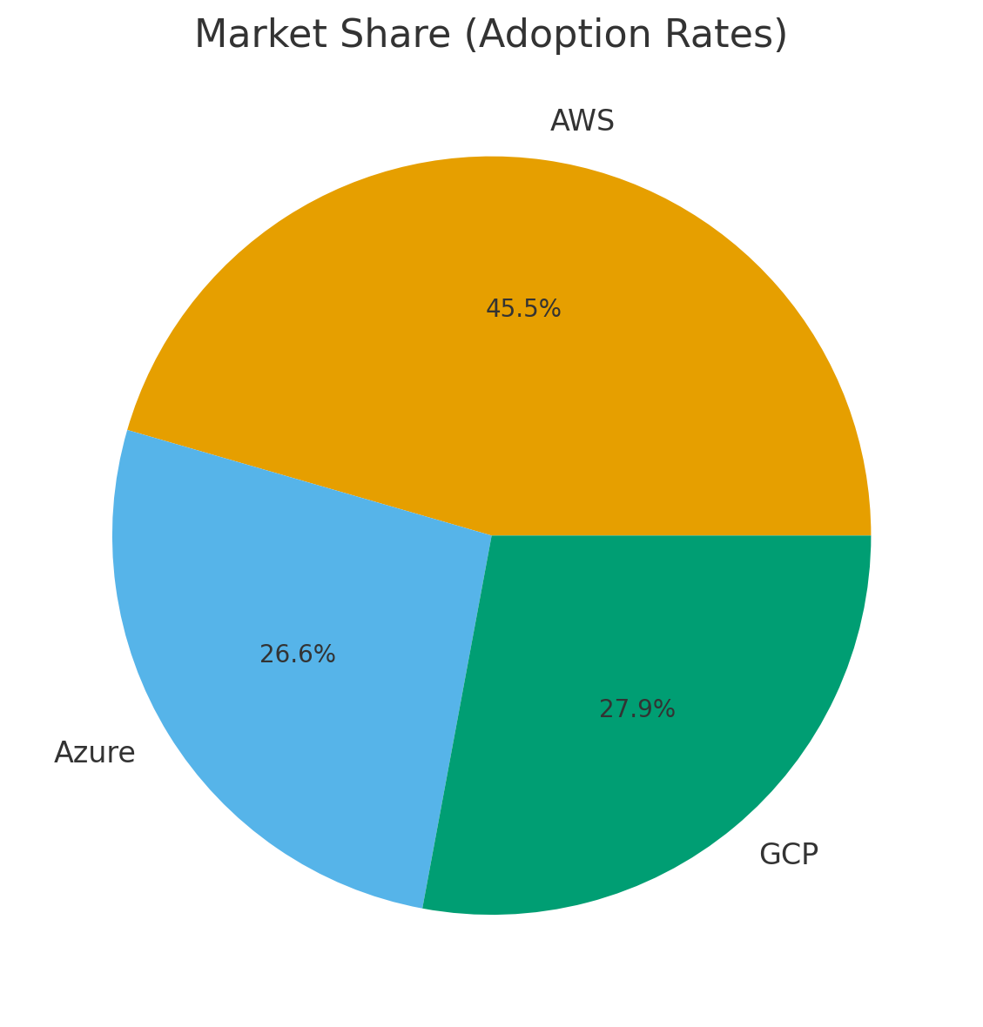
Statistical Results - Test Outcome/Interpretation- 3
AWS holds the largest market share, showing it remains the most widely used platform across enterprises, startups, and government, which increases job availability for AWS skills.
GCP and Azure have similar adoption levels, indicating competitive but more niche demand compared to AWS.
The near tie between Azure and GCP suggests that multi-cloud strategies are common and that skills in either service still support strong employability.
Overall, AWS dominates hiring demand, while Azure and GCP provide growing opportunities, especially in companies already invested in Microsoft or Google ecosystems.

Slide 9
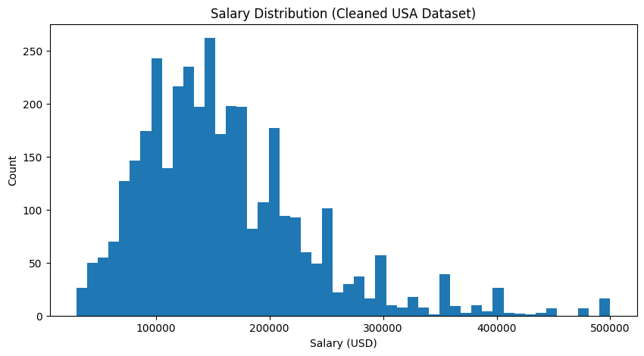
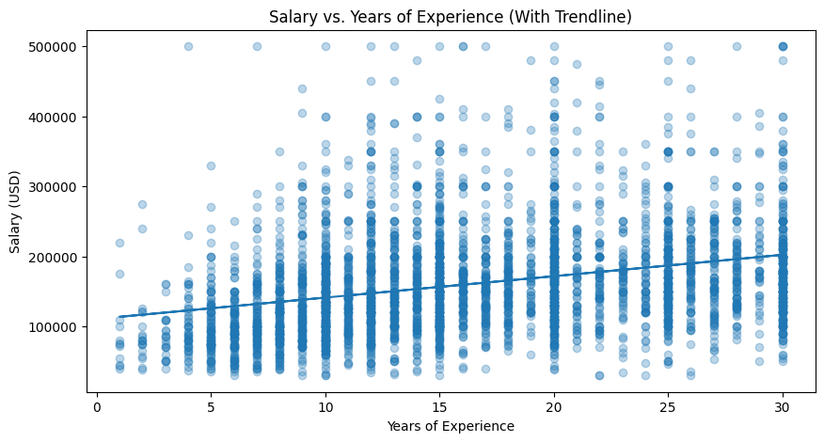
Salaries cluster heavily between $100k–$200k, showing this is the typical pay range for most cloud-related roles in the U.S.
The long right tail (up to $500k) shows that top earners—usually senior engineers, architects, or managers—can make far more, but these roles are much less common.
The distribution is right-skewed, meaning a small group of highly experienced or specialized professionals drive up the top end of cloud salaries.
There is a positive upward trend, confirming that salary generally increases with experience.
However, the points are widely scattered, meaning experience alone doesn’t guarantee higher pay—skills, certifications, company size, and role type also matter.
Even at low experience levels (0–5 years), some people earn well above $200k, showing that high-paying roles are accessible early for those with in-demand cloud skills.
At higher experience levels (15+ years), pay spreads even more, indicating greater variation in career paths—from mid-level engineers to high-earning managers and architects.

Slide 10
Business Recommendations/Review - 1
Cloud Certification ROI Cloud certifications provide strong ROI because cloud roles pay well and have high growth potential. Senior and architecture-focused certifications lead to the highest returns. Roles like Engineering Manager and Architect earn the most, meaning advanced or multi-cloud certifications can lead to higher-paying leadership and design positions.
Which Platform to Standardize On AWS is the best platform to standardize on due to its dominant market share and the widest range of job opportunities. Azure and GCP are valuable, but their demand is smaller and more dependent on company-specific ecosystems.
Skill Demand vs. Supply Dynamics Salary variation and high-end outliers suggest strong demand and limited supply of advanced cloud skills, especially for senior architecture and management roles. Developer roles have tighter salary ranges, implying a larger supply of candidates. AWS skills are in highest demand due to adoption rates, while Azure and GCP skills remain competitive but less widely required.

Slide 11



Business Recommendations - 2
Increase upper-end salary potential, since Azure roles tend to cluster more tightly and have fewer extreme high earners.
Enhance hands-on learning, because many Azure roles rely on Microsoft ecosystem familiarity, limiting newcomers.
Support career mobility, helping Azure learners transition into higher-paying architect and manager tracks.
AWS
GCP
Narrow the salary spread by creating clearer leveling, since AWS-related roles show high variability and many outliers.
Improve skill accessibility, because AWS’s complexity requires more experience to reach higher-paying roles.
Strengthen training pathways, as its dominant market share means demand is high but talent pipelines lag behind.
Boost demand relative to supply, because GCP’s smaller market share creates fewer high-salary roles overall.
Expand role diversity, since most high-paying GCP positions center on data/ML rather than broad cloud operations.
Create clearer certification-to-job pipelines so learners can convert skills into higher salaries more reliably.
Azure

